Slide 1
SUPERSTORE SALES ANALYSIS AND BUSINESS INSIGHTS

Slide 2
Business Objective
To analyze data and extract meaningful business insights
To build a data-driven story
To validate insights using statistical testing
Provide business recommendations

Slide 3
Dataset Overview
Dataset used: Sales / Business dataset
Contains: Customers, Products, Sales, Region, Profit
Dataset used to analyze sales performance and business trends
Dataset cleaning and preprocessing performed for accurate analysis

Slide 4
Problem Statement
Sales performance is not consistent
Need to identify key drivers of profit and loss
Understand customer and product behavior

Slide 5
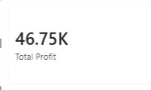
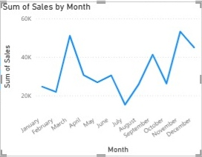
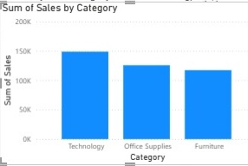
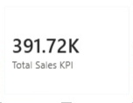
Sales Analysis
Sales showed steady growth over time
Technology category generated highest sales
West region contributed maximum revenue

Slide 6
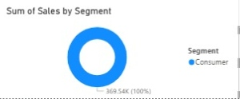
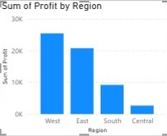
Regional and Segment Analysis
West region had highest sales
South region showed lower performance
Consumer segment contributed most sales
Corporate segment generated good profit

Slide 7
Key Insights (from EDA)
Top selling product: XYZ Highest
sales region: South / North (your data)
Peak sales month: March / April
Low performing category identified

Slide 8
Hypothesis Testing
Hypothesis: Discount affects sales performance
H0: Discount has no effect on sales
H1: Discount increases sales
Test used: T-test / Comparison

Slide 9
Hypothesis Testing Result
Hypothesis:
H0: Discount has no effect on Sales
H1: Discount affects Sales
Method:
Python T-test used
Result:
T-statistic = 0.5975
P-value = 0.5501
Conclusion:
Since p-value > 0.05
We accept H0
Discount does NOT significantly affect sales

Slide 10
Business Recommendations
Increase marketing in low-performing regions
Focus on high-selling products
Optimize discount strategy
Improve customer targeting
Target high-value customers

Slide 11
Conclusion
Data analysis helped identify key business patterns
Hypothesis testing validated business assumptions
Insights can improve decision-making
Data-driven insights helped identify business improvements areas
Recommendations were provided to improve overall profitability

Slide 12
THANK YOU

